Slide 1
Fiji Spring Break Sweepstakes
Best Marketing and Communications to Increase Ridership or Sales, Comprehensive Campaign

Slide 2
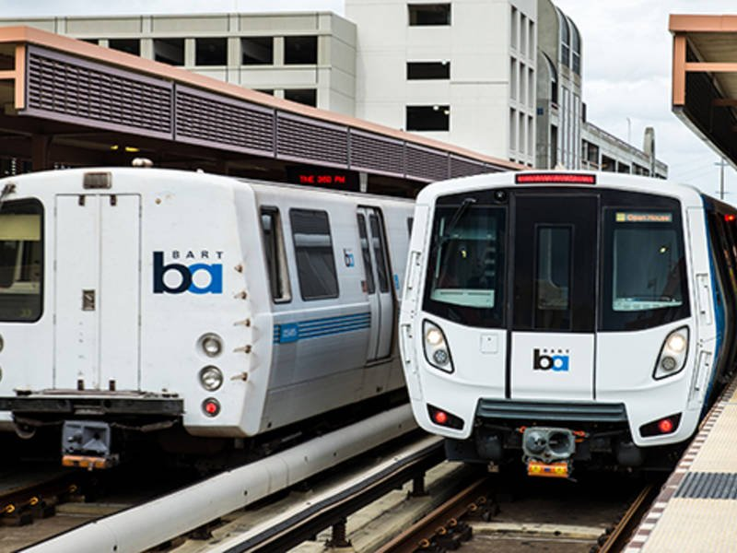
The problem
BART has not been immune to the challenges that other transit agencies across the nation face.
BART has seen a decrease in ridership, especially on the weekends and to the airport.

Slide 3
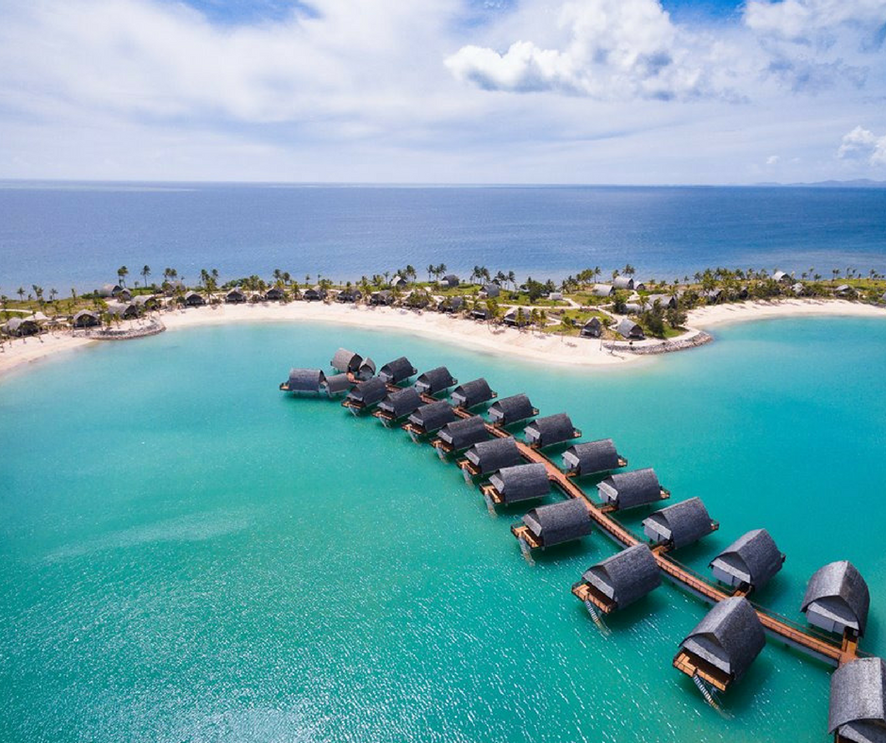
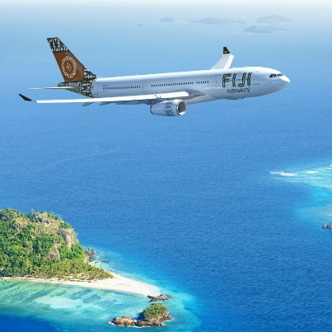
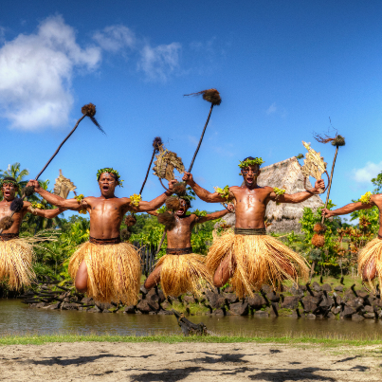
The solution
To combat this trend, we launched a Spring Break Escape campaign to remind riders that BART is an easy way to travel to the airport and connect you to a world of destinations
To make people feel connected to the campaign, we asked riders to enter our sweepstakes
The prize was a $5,000 trip to Fiji, courtesy of Fiji Airways, Tourism Fiji and Fiji Marriott Resort
Promotion ran from April 1-29

Slide 4
Spring Break Escape to Fiji
Users submitted their email address to enter the sweepstakes
To unlock “bonus” entries, people could tweet about the contest and follow @SFBARTable on Instagram

Slide 5
New ways to target riders
This is the first campaign where we incorporated a comprehensive digital marketing strategy, including re-targeting ads, SEO, market segmentation based on demographic data and interests, and tracking where users convert in the marketing funnel (in our case, when they subscribed to our email database).
BART targeted marketing to Bay Area residents who were interested in travel and public transit.
BART ran ads on trains, local radio stations and the internet to promote riding BART to the airport and to enter the sweepstakes.

Slide 6
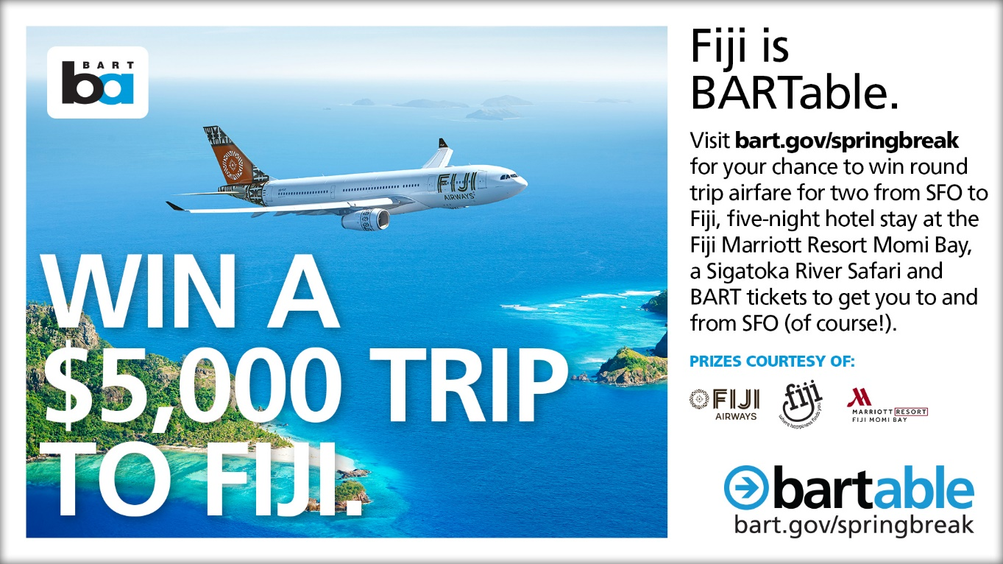
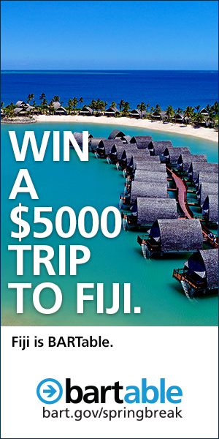
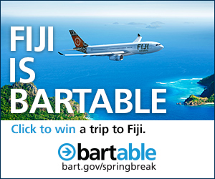
Digital Ads

Slide 7
Video
Link to video: https://vimeo.com/301914231

Slide 8
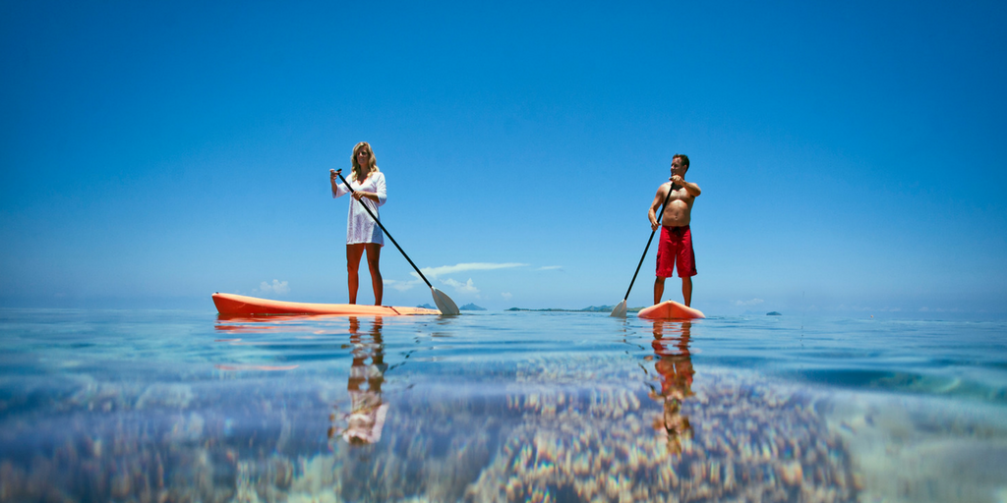
Radio Ads

Slide 9
The results …
Highest traffic month to BARTable website
73,454 new users
87,000 page views on the landing page
Digital Ads were highly effective
Clicks: 35k+
Impressions: 8 million
Average Cost Per Click: $0.56
Click Through Rate: 0.43%

Slide 10
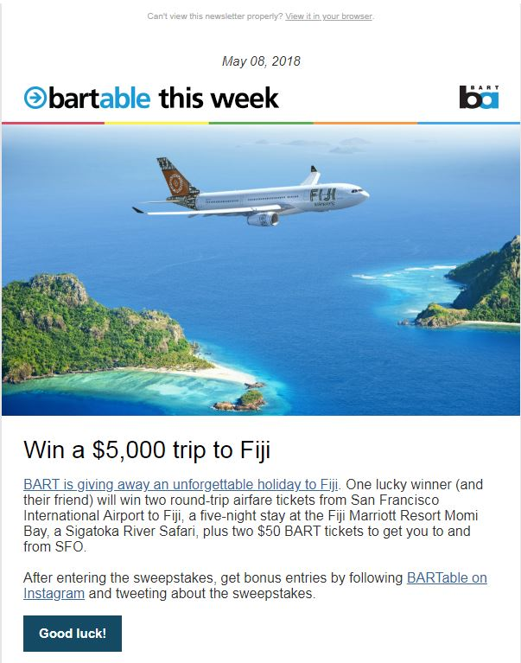
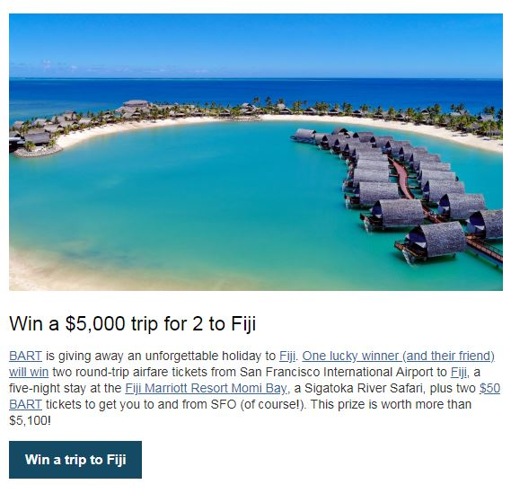
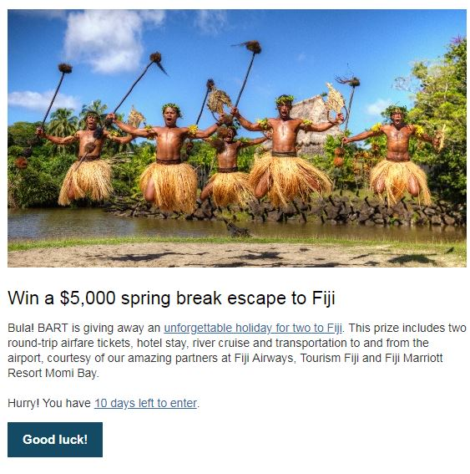
Email Newsletter
4 emails sent during time of promotion
25,096 new email subscribers, bringing the total to 80,000
Email | Open Rate | Click Rate
April 5 | 23.2% | 11.9%
April 12 | 21.8% | 7.1%
April 19 | 19.1% | 5.5%
April 26 | 20% | 7%
Average | 21% | 7.9%
Industry average for Travel and Transportation
- 20.69% open rate - 2.17% click through rate
Notes:
Avg Open Rate: 20.6%
Avg CTR: 7.3%

Slide 11
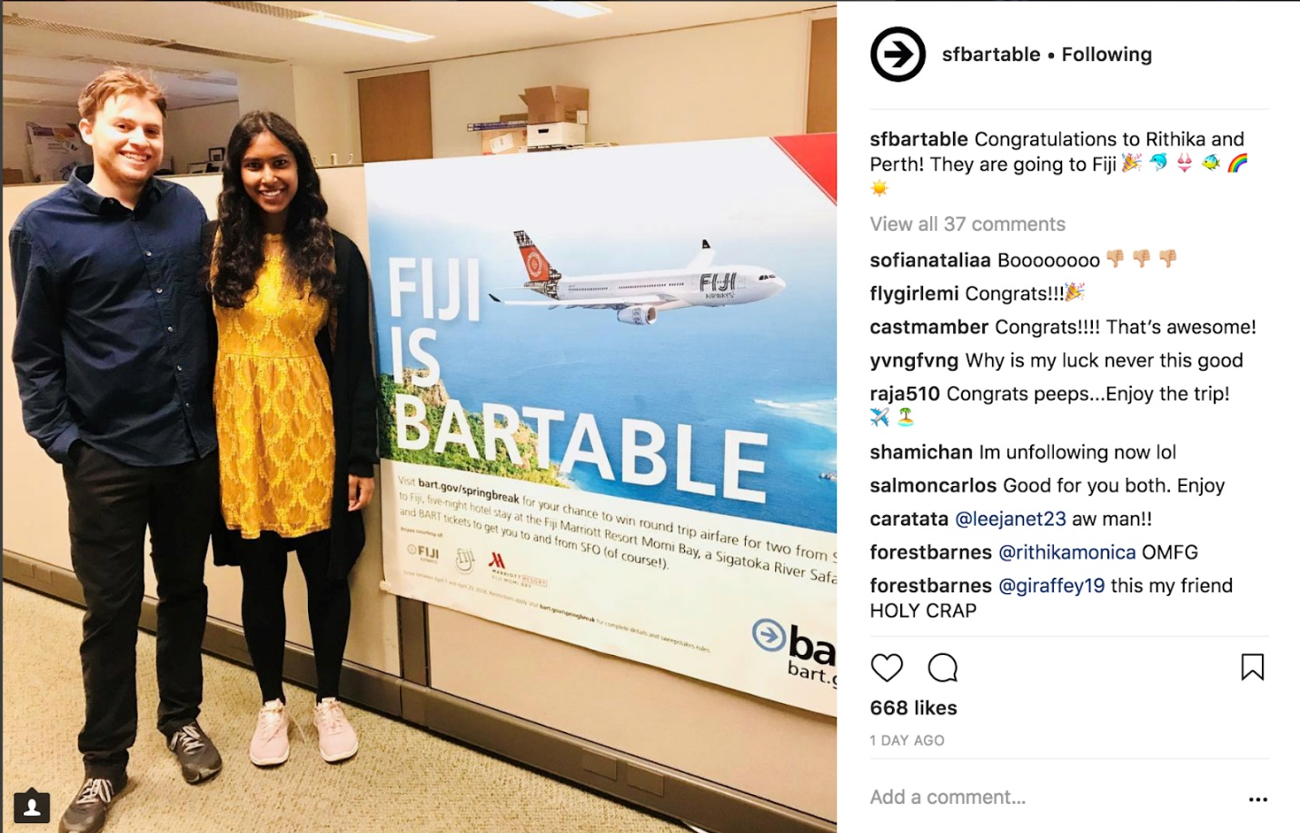
Instagram
Gained 7,613 new Instagram followers

Slide 12
Post campaign
We surveyed visitors, and got lots of positive feedback …
It made me feel that riding BART was more than just a mode of transport to get to work. Felt as if BART cares for and values the commuters :)
I thought it was a really cool sweepstakes!! And I'm a lot more involved with Bart advertisements now.
I didn’t realize BART was so cutting edge and at the forefront of public transportation. This is a great way to get people excited about riding BART and discussing interesting neighborhoods around BART.
I was excited about the Fiji contest and sent the info along to others I know in the area. It was great to imagine winning (I never win contests lol) and made me want to vacation. It also reminded me that bart was very easy for me to use too.
It was a really fun and exciting chance to be entered to win such a great price and trip! It kept Bart on my mind for a whole month!!!

Slide 13
AdWheel Consideration
The campaign spread greater public awareness of using BART. It’s worthy of an AdWheel because we were able to reach new audiences using re-targeting ads and demographic data from Facebook.
We were successful in signing up 25,000 new BARTable email subscribers, which we now use both to build off-peak ridership and to educate people on the new initiatives BART is rolling out for the public, including new train cars, repair work, and station modernization.

